Slide 1
EIT x Soft Robots: project update
Week of Monday 07/06/2021

Slide 2
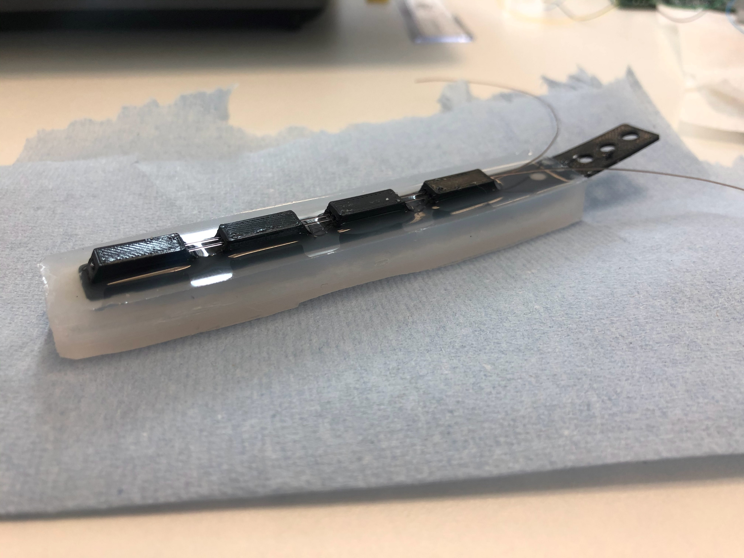
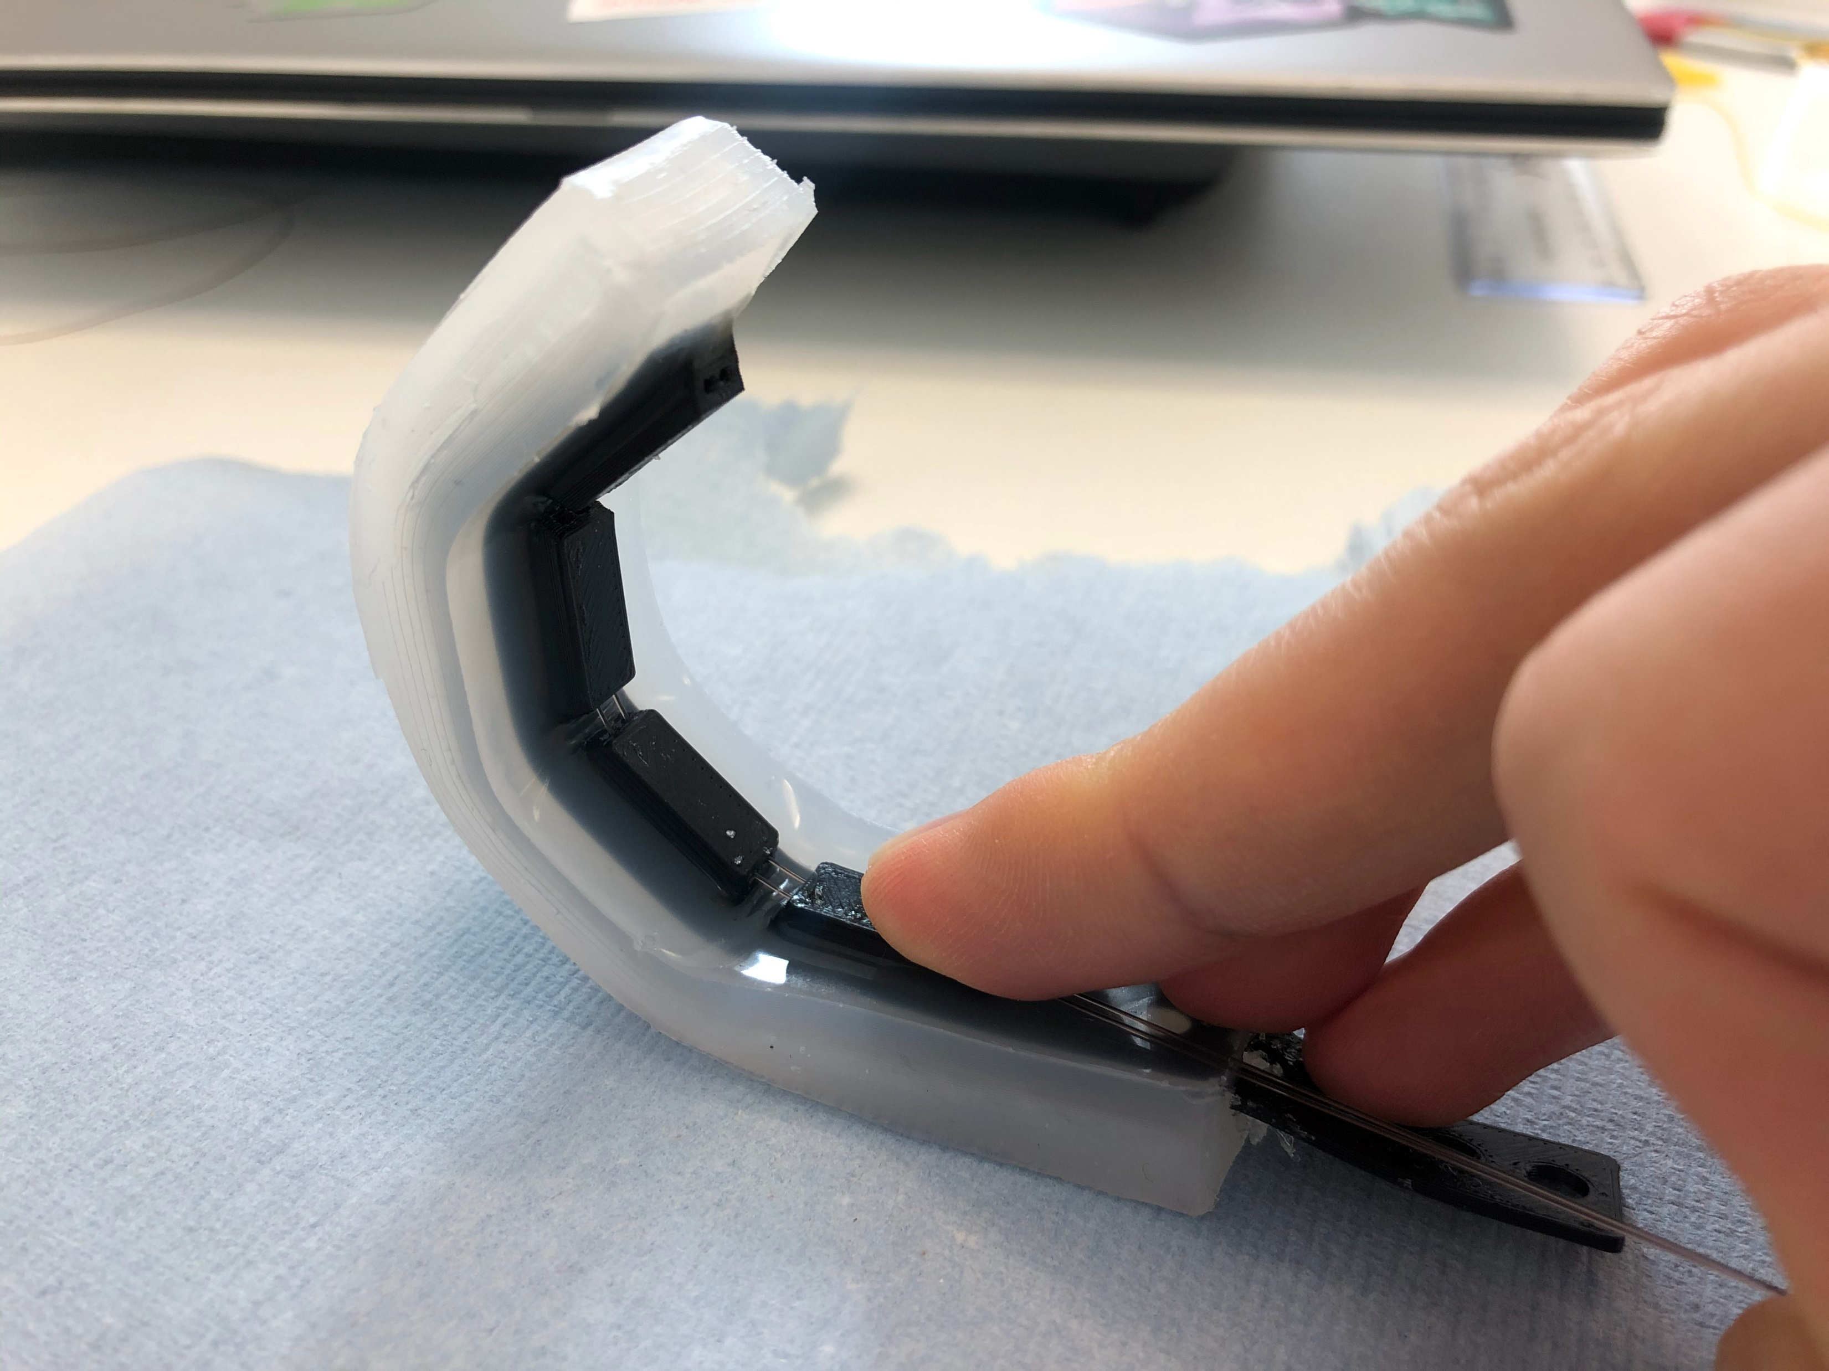
SDM actuator
Cable-driven flexible “bone”
Saline chamber
Saline chamber
Cables

Slide 3
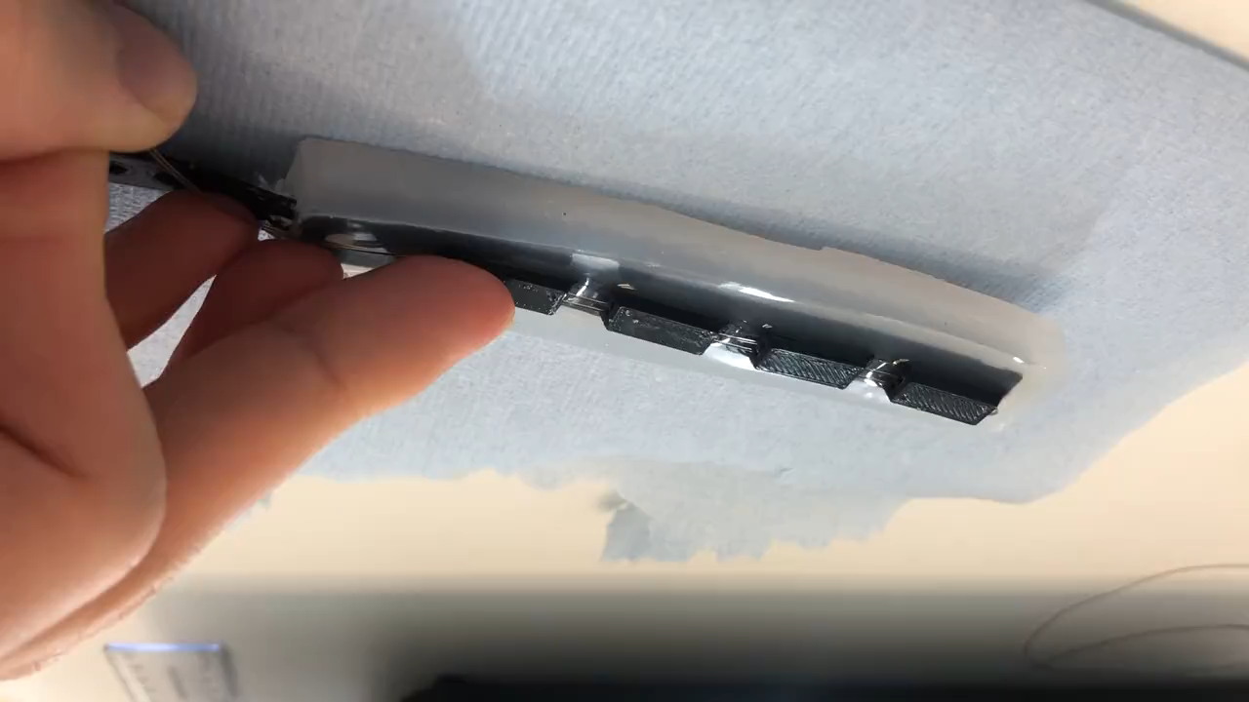

Slide 4
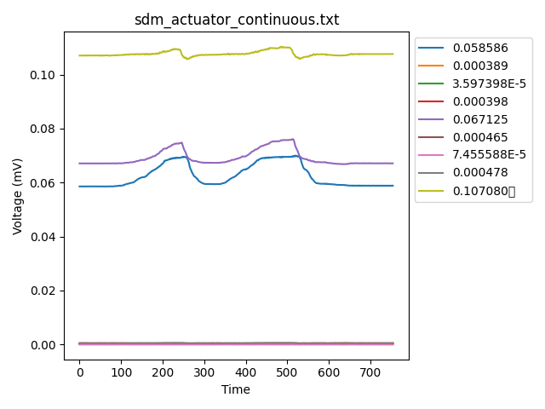
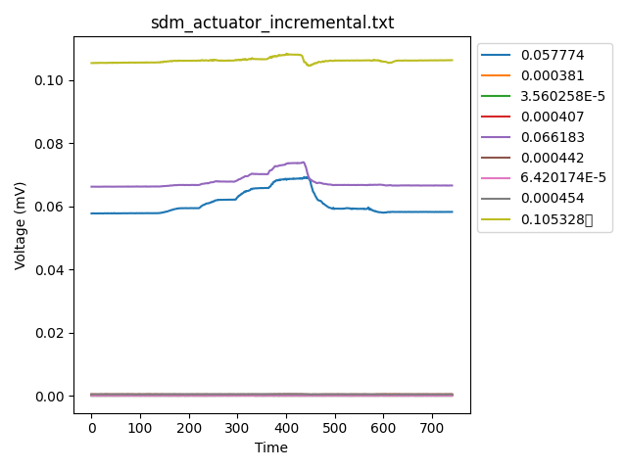
SDM actuator EIT data
20mm pull of cable
20mm pull of cable
10mm pull of cable
Voltage reading over a 60ml pneumatic actuation (10ml at a time, ~1-2s per 10ml)
Actuated to 22.5°

Slide 5
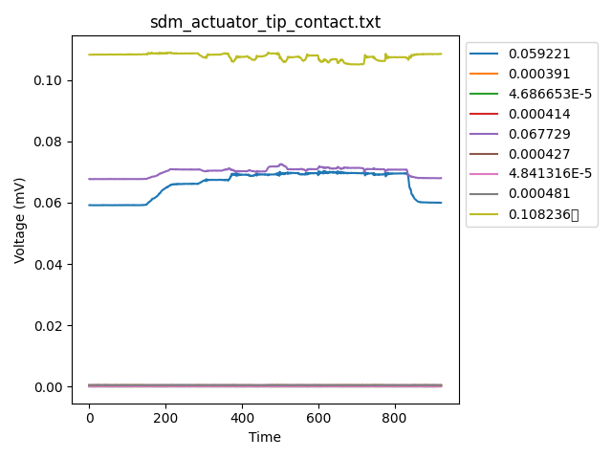
SDM actuator EIT data
20mm change in cable length to flex actuator
Force against actuator tip

